Slide 1
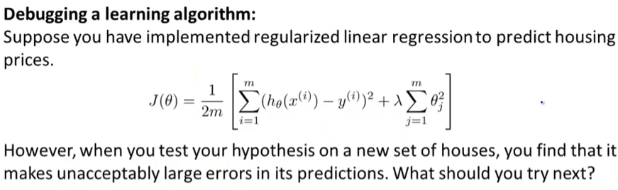
Get more training examples
Try smaller set of features to avoid over fitting
Try getting additional features
Try adding polynomial features
Try increasing/decreasing lambda

Slide 2
How to evaluate learning algorithm?
Machine learning diagnostic: Test that you can run to gain insight into what is/is’nt working with learning algorithm and gain guidance to improve the performance of algorithm.
Diagnostics are not trivial and can take time to implement

Slide 3
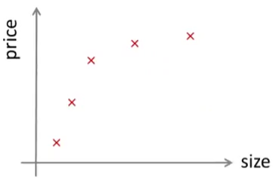

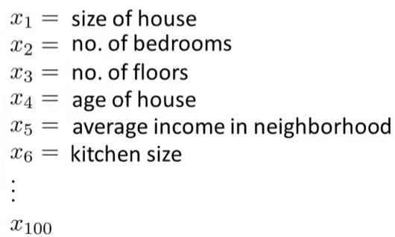

How to evaluate hypothesis?

Slide 4
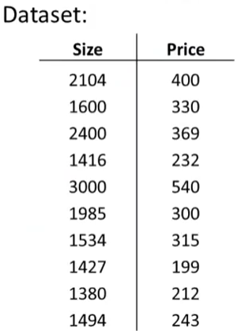
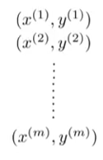
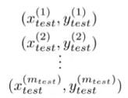
Evaluating hypothesis
Training Set
Test Set

Slide 5

Training/Testing Procedure for linear regression
Learn parameter θ from training data by minimizing training error J(θ)
Compute test set error

Slide 6

Training/Testing Procedure for logistic regression
Learn parameter θ from training data by minimizing training error J(θ)
Compute test set error
misclassification error (0/1 misclassification error)
1 if h_{θ}(x) > 0.5, y=0
if h_{θ}(x) < 0.5, y=1
0 Otherwise
Err(h_{θ}(x) ,y) =
Test Error?

Slide 7
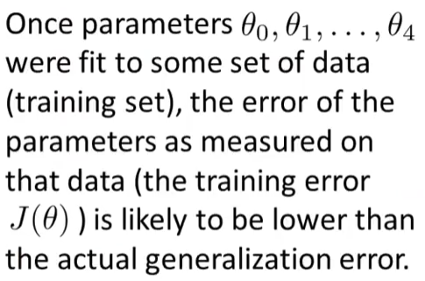
Model Selection

Slide 8
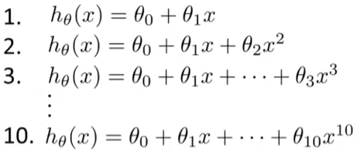


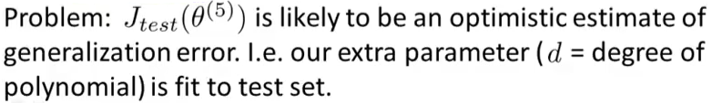
Model Selection
Here we need to find the degree of polynomial that works well on unseen examples
Θ⁽¹⁾ → J_{test}(Θ⁽¹⁾ )
Θ⁽²⁾ → J_{test}(Θ⁽²⁾ )
Θ⁽³⁾ → J_{test}(Θ⁽³⁾ )
Θ⁽¹⁰⁾ → J_{test}(Θ⁽¹⁰⁾ )

Slide 9
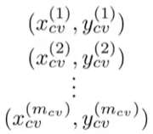
Model Selection
Training Set
Cross Validation (CV) Set
Test Set

Slide 10
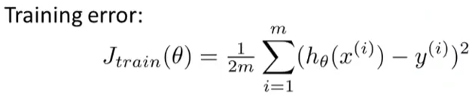
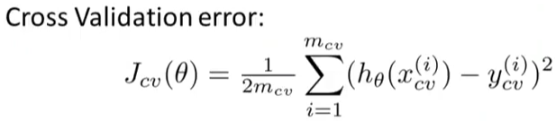
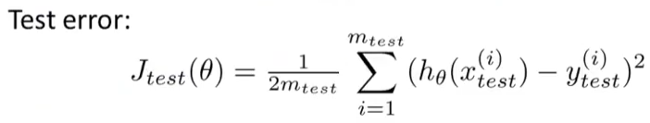
Train/Validation/Test Error

Slide 11

Model Selection
Here we need to find the degree of polynomial that works well on unseen examples
Θ⁽¹⁾ → J_{cv}(Θ⁽¹⁾ )
Θ⁽²⁾ → J_{cv}(Θ⁽²⁾ )
Θ⁽³⁾ → J_{cv}(Θ⁽³⁾ )
Θ⁽¹⁰⁾ → J_{cv}(Θ⁽¹⁰⁾ )

Slide 12
Diagnosing Bias and Variance
If a predictor/algorithm does not work as expected it is generally because of high bias (under-fitting) or high variance (over-fitting)
If we can identify bias or variance problem, it is critical in improving performance of predictor

Slide 13
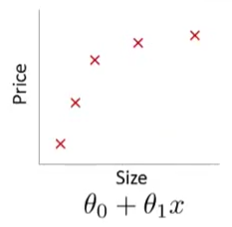
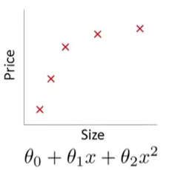
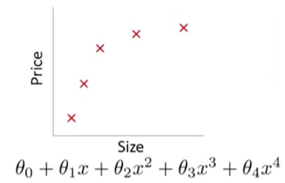
Example: Linear Regression
Under fit
High bias
i.e. prices of houses will vary linearly
Over fit
High variance
i.e. The space of high order polynomial hypothesis is too large and variable and can fit anything.
Just Right

Slide 14
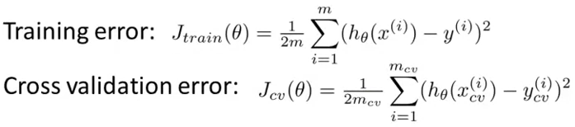
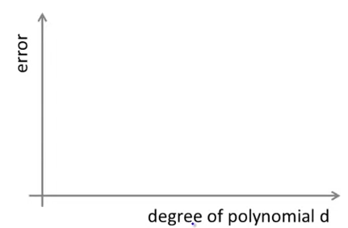
Diagnosing Bias and Variance
How to know high bias or high variance?
J_{cv}(θ) or J_{test}(θ)
High Bias Problem (under-fit):
High training and validation errors
J_{train} is approximately equal to J_{cv}
J_{train}(θ)
High Variance Problem (over-fit):
Low training error
J_{cv} >> J_{train}

Slide 15
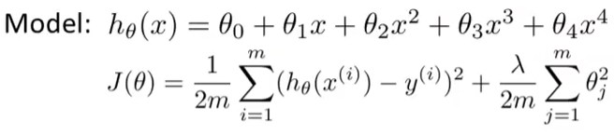
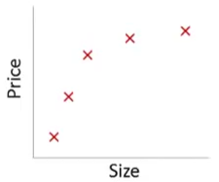
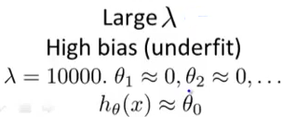


Regularization and Bias/Variance

Slide 16
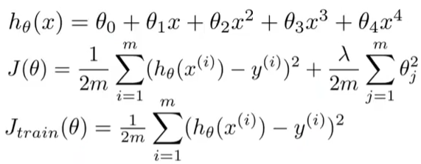
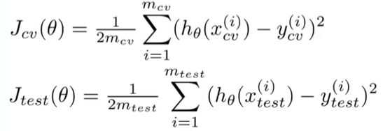
Choosing Regularization Parameter

Slide 17
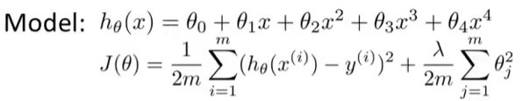
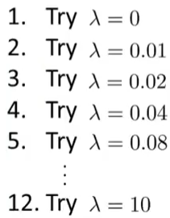
Choosing Regularization Parameter
Θ⁽¹⁾ → J_{cv}(Θ⁽¹⁾ )
Θ⁽²⁾ → J_{cv}(Θ⁽²⁾ )
.
.
Θ⁽⁴⁾ → J_{cv}(Θ⁽⁴⁾ )
.
.
.
.
Θ⁽¹²⁾ → J_{cv}(Θ⁽¹²⁾ )

Slide 18
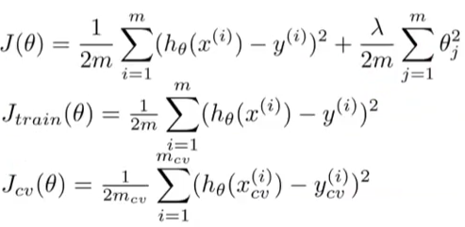
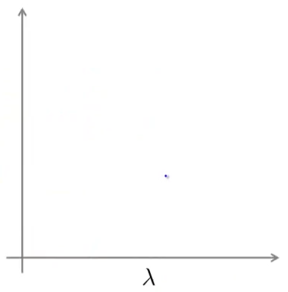
Bias/Variance as a function of
High Variance
High Bias
J_{cv}(θ) or J_{test}(θ)
If small/large lambda then?
J_{train}(θ)

Slide 19
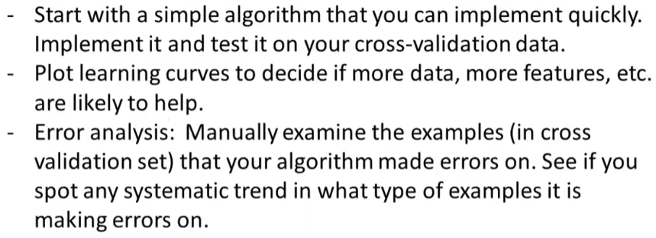
Error Analysis
Recommended Approach

Slide 20
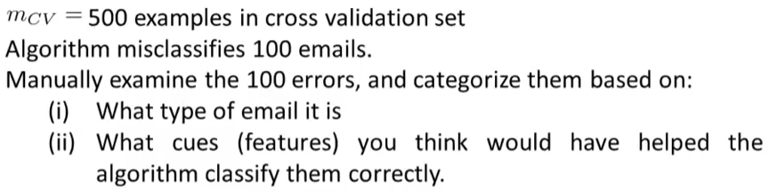
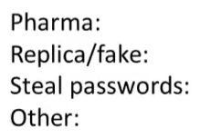
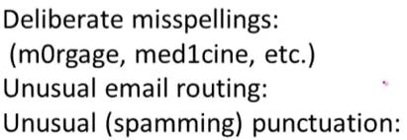
Error Analysis
Example
10
6
6
55
16
29
30

Slide 21
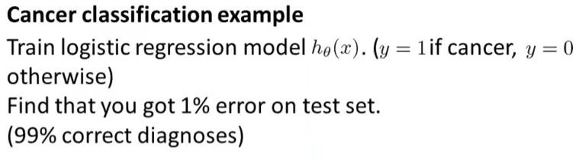
Error Metrics for Skewed Classes
We find that only 0.5% patients in train and test set have cancer ………..
When there is large imbalance between positive and negative classes, we call it as skewed data/classes. Hence classification accuracy is a poor metric here …..

Slide 22
Error Metrics for Skewed Classes
To cope with the problem of skewed classes we use different metrics:
Precision
Recall

Slide 23
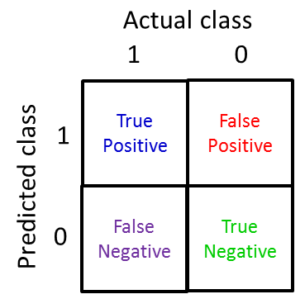
Error Metrics for Skewed Classes
To understand these first lets define some important terms
True Positive (Actual class = 1 and Predicted class = 1)
True Negative (Actual class = 0 and Predicted class = 0)
False Positive (Actual class = 0 and Predicted class = 1)
False Negative (Actual class = 1 and Predicted class = 0)

Slide 24
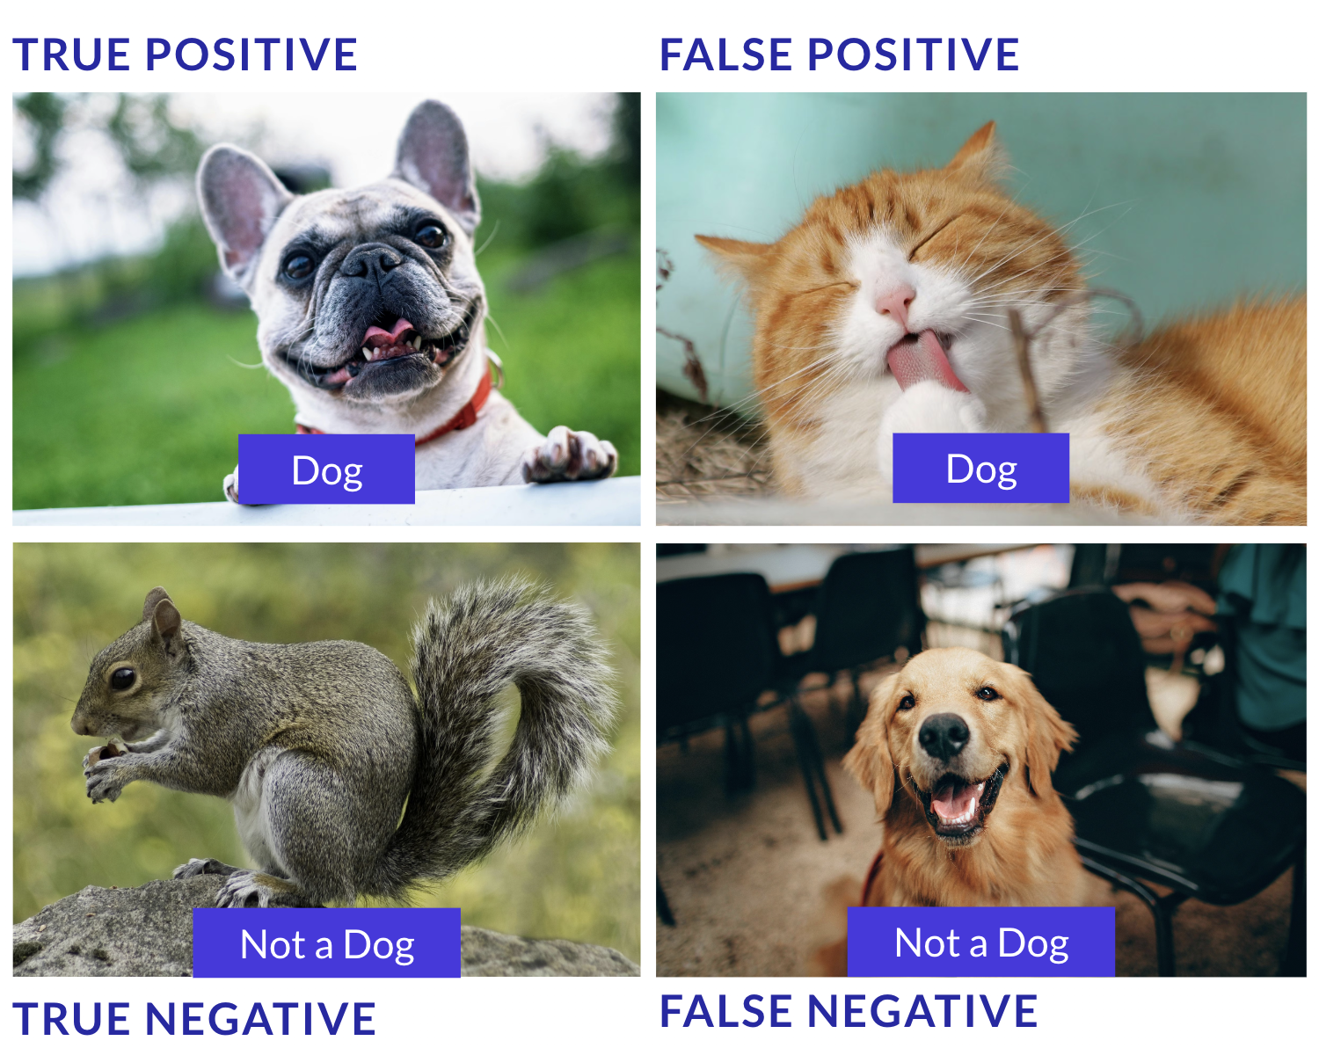
FP and FN also called Type-1 and Type-2 errors

Slide 25
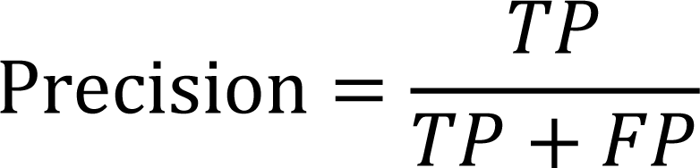
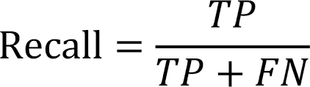
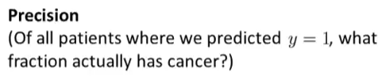
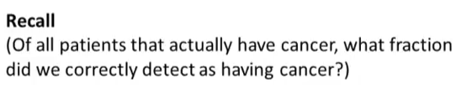
Error Metrics for Skewed Classes
True Positive (TP)
True Negative (TN)
False Positive (FP)
False Negative (FN)

Slide 26


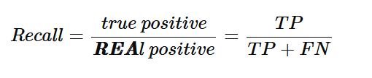
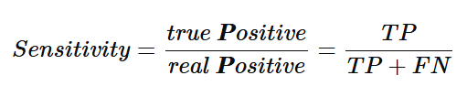

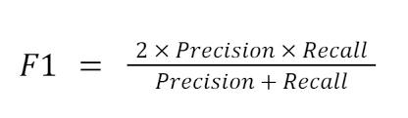

Slide 27
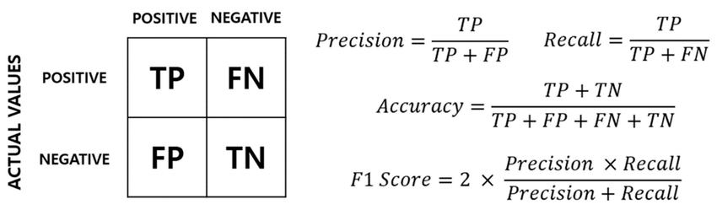

Slide 28
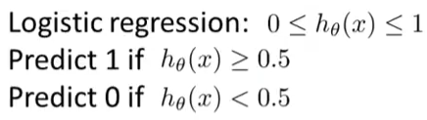

Precision-Recall Tradeoff
How can we do this?
Increasing threshold i.e. more confidence results in higher precision and lower recall

Slide 29

Precision-Recall Tradeoff
We set a lower threshold ……
Result is a classifier with higher recall but lower precision ……

Slide 30
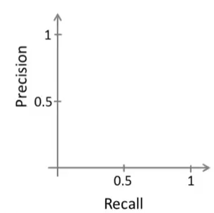
Precision-Recall Tradeoff
High threshold
Low threshold

Slide 31
High Threshold (arrow near top-left): A strict threshold (e.g., only predict "positive" if score > 0.9). This yields high precision but low recall—great for minimizing false positives (e.g., in fraud detection where false alarms are costly).
Low Threshold (arrow near bottom-right): A lenient threshold (e.g., predict "positive" if score > 0.1). This yields high recall but low precision—useful when missing positives is worse (e.g., cancer screening).

Slide 32
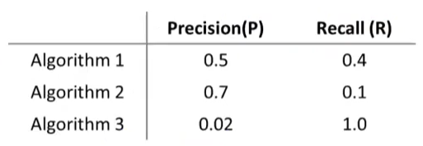

Precision-Recall Tradeoff
How to choose best algorithm now? We have two numbers precision and recall.

Slide 33
Algorithm | Precision (P) | Recall (R) | F1 Score
Algorithm 1 | 0.5 | 0.4 | 0.4444
Algorithm 2 | 0.7 | 0.1 | 0.175
Algorithm 3 | 0.02 | 1.0 | 0.0392

Slide 34
Discussion
Which is better?
Better algorithm
More data

